Slide 1
Digital Portfolio
STUDENT NAME: R.Sampathkumar
REGISTER NO AND NMID: 37EB5B798092298ADD640A91A658E5D0
DEPARTMENT:B.sc computer science
COLLEGE: COLLEGE/ UNIVERSITY:P.S.P.T MGR Government Arts And Science college, puthur

Slide 2
PROJECT TITLE
Student Profile card system

Slide 3


AGENDA
Problem Statement
Project Overview
End Users
Tools and Technologies
Portfolio design and Layout
Features and Functionality
Results and Screenshots
Conclusion
Github Link
3/21/2024 Annual Review

Slide 4

PROBLEM STATEMENT
Small restaurants often lack a proper online presence, making it difficult for customers to find important details such as menus, opening hours, or contact information. This reduces visibility and customer reach. To overcome this, a Restaurant Website using HTML, CSS, and JavaScript has been developed, ensuring customers can easily access information and owners can attract more business.

Slide 5

PROJECT OVERVIEW
The project is a responsive restaurant website designed to display the restaurant’s services, menu, gallery, and contact information in a visually appealing and structured way. The website is aimed at small businesses that need an affordable digital solution for expanding their online presence.

Slide 6

WHO ARE THE END USERS?
Restaurant Owners → To promote their restaurant online.
Customers → To easily view menu, services, and book reservations.
Food Enthusiasts → To explore new places to dine.

Slide 7

TOOLS AND TECHNIQUES
HTML5 → For website structure.
CSS3 → For styling, responsiveness, and layout design.
JavaScript → For dynamic and interactive features.
Visual Studio Code → Development environment.
GitHub → Version control and hosting.

Slide 8
POTFOLIO DESIGN AND LAYOUT
The website follows a clean and user-friendly layout:
Home Page → Introduction with a welcome banner.
About Us → Restaurant background, vision, and mission.
Menu Page → Categorized food and drinks list with pricing.
Gallery → Pictures of food items and restaurant ambience.
Contact Page → Contact form, phone, email, and Google Maps integration.
8

Slide 9
FEATURES AND FUNCTIONALITY
Fully responsive (works on mobiles, tablets, and desktops).
Navigation bar for easy movement across sections.
Categorized menu with prices.
Image gallery for restaurant highlights.
Contact form with reservation requests.
Embedded Google Maps for location.
Social media icons for connectivity.

Slide 10
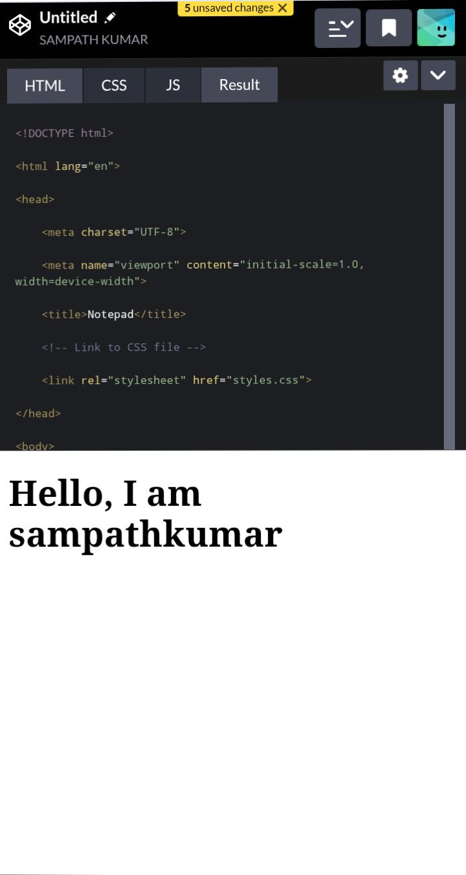
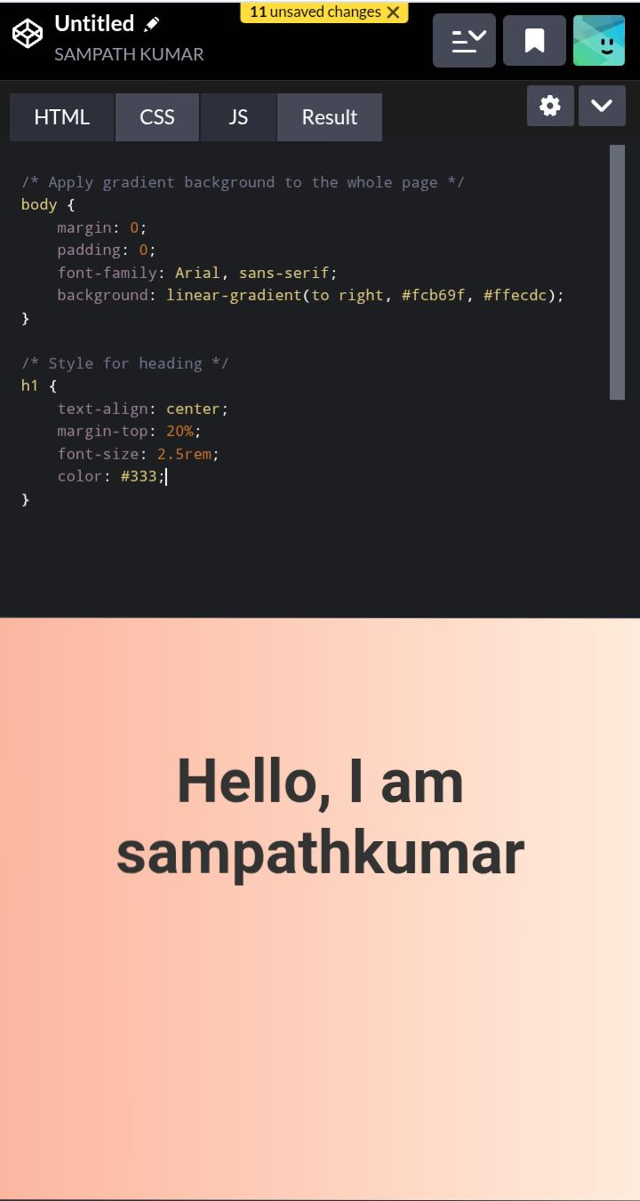

RESULTS AND SCREENSHOTS
3/21/2024 Annual Review
10

Slide 11
CONCLUSION
The project successfully delivers a digital presence for restaurants through a responsive and user-friendly website. It enhances customer engagement, makes restaurant details easily accessible, and demonstrates the effective use of HTML, CSS, and JavaScript in solving real-world problems.
11

